Slide 1



Melissa Farrell | Senior Project
Northern Michigan University | Winter 2019
fiestamarket.app
api.fiestamarket.app

Slide 2
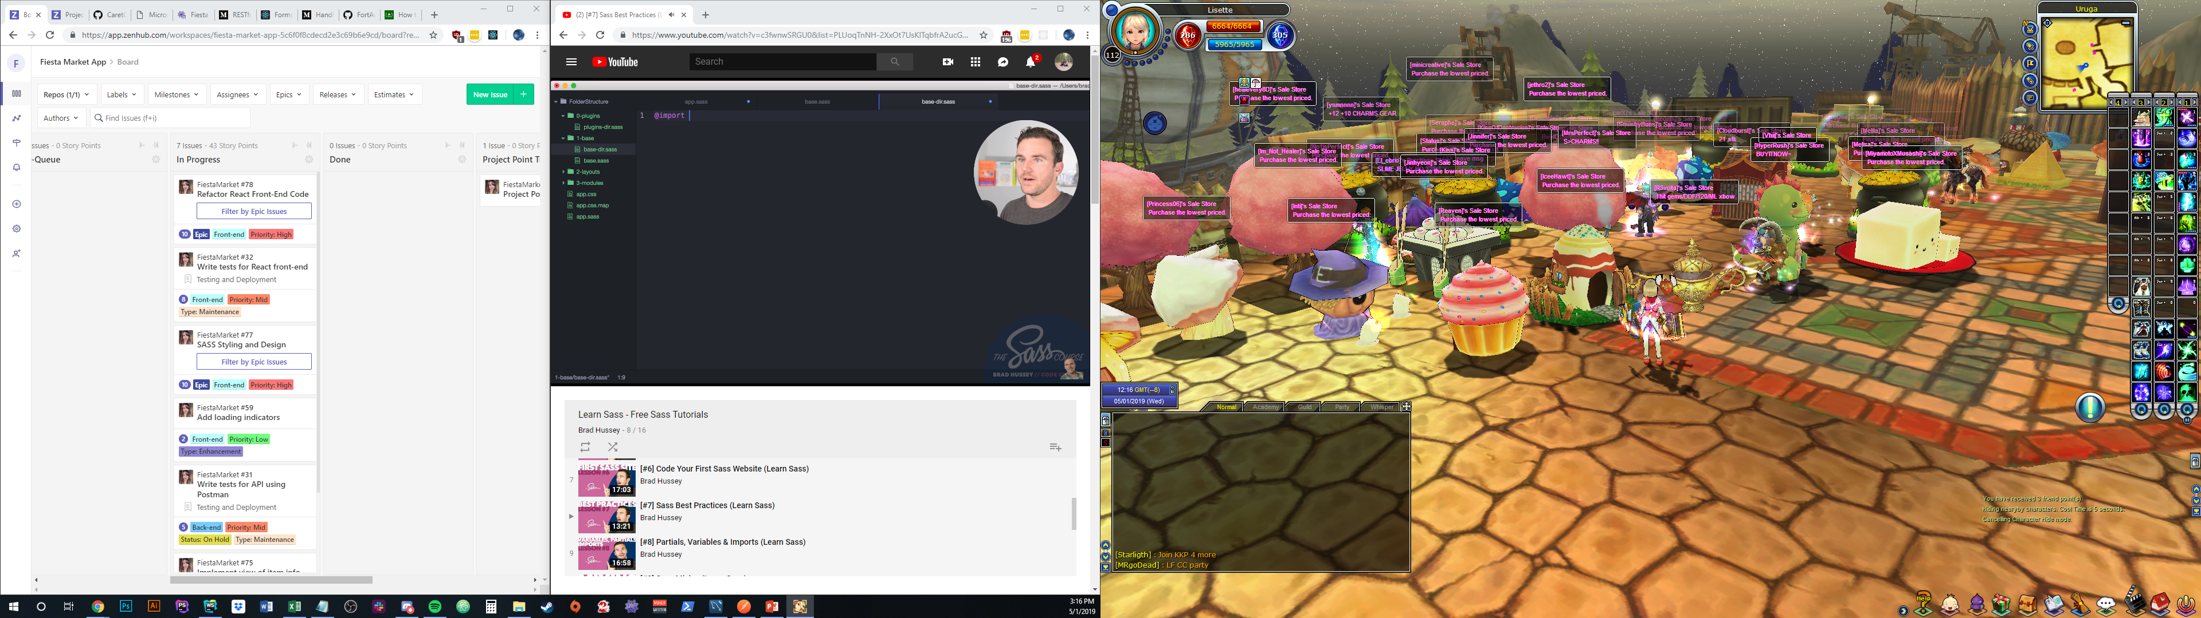
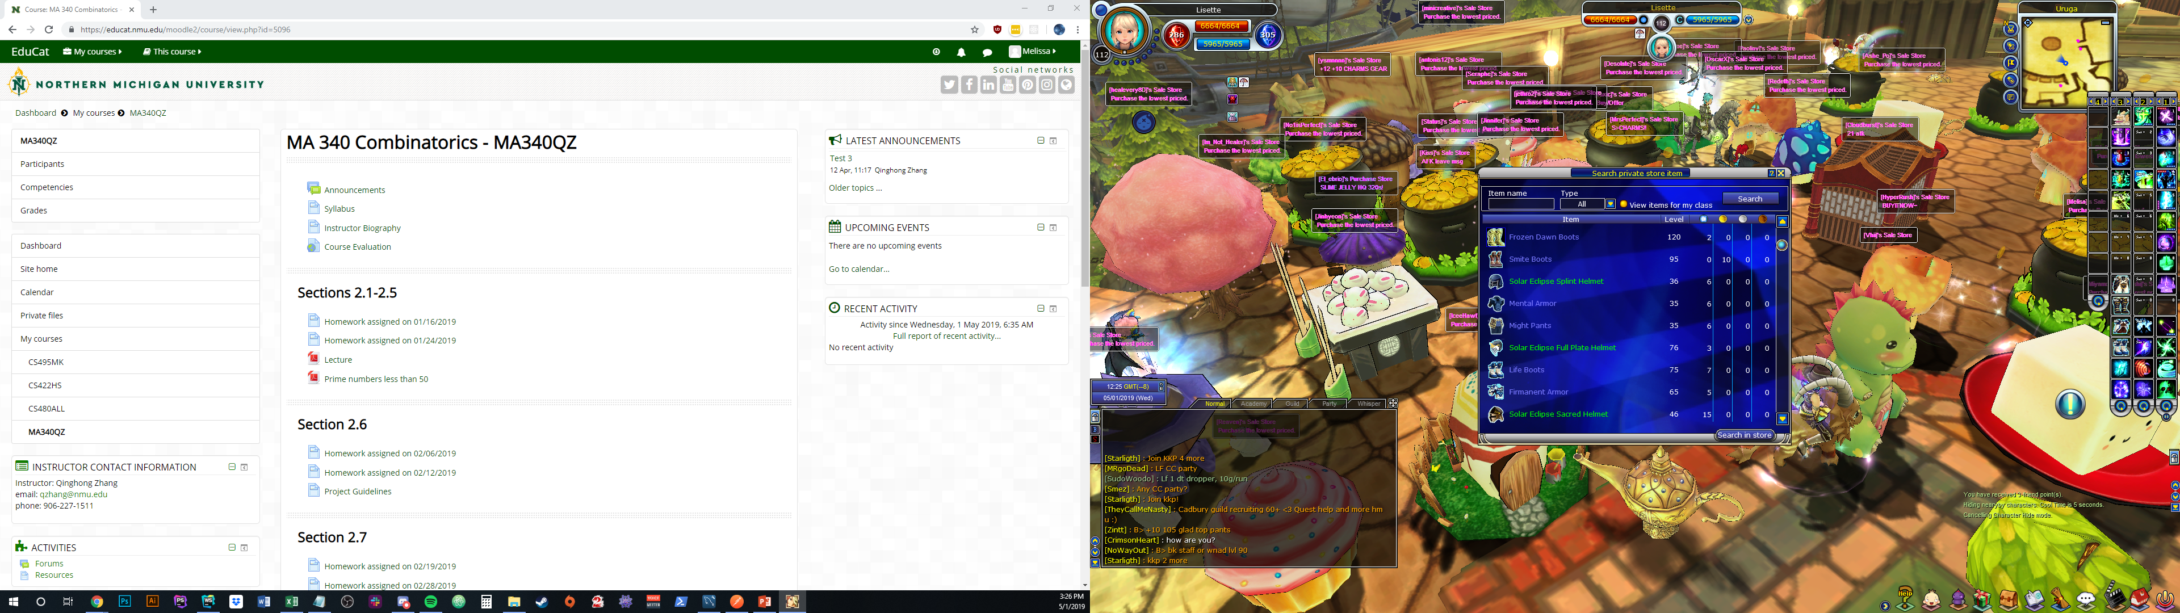
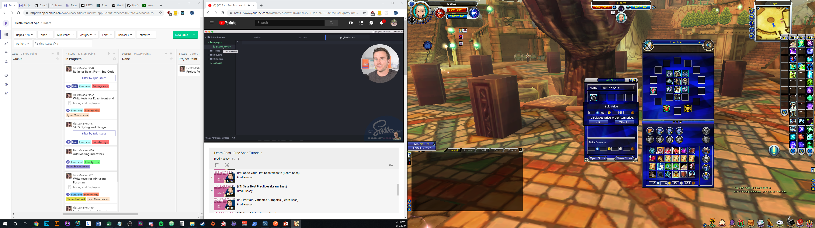
Why Fiesta Market?
Learn React
Solve a real problem for real users
Make something fun

Slide 3











Languages & Libraries
bcrypt
React Router
Passport.js
Axios

Slide 4
What was new?
bcrypt
React Router
Passport.js
Axios

Slide 5

Hosting
React App:
Hosted in an AWS Simple Storage Service bucket
HTTPS handled through AWS CloudFront CDN with AWS Certificate Manager
Node.js API:
Hosted on AWS Lightsail server
HTTPS handled by apache mod-proxy with LetsEncrypt certificate
MySQL Database:
Hosted on AWS Lightsail server

Slide 6
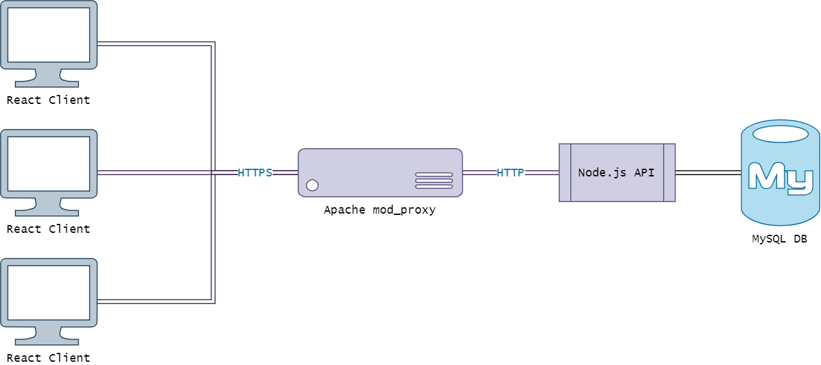

Server Setup
*
*
*
*React client pulled from AWS S3 bucket through AWS CloudFront

Slide 7

Node.js Express API
Semi-RESTful API endpoints
Tested with Postman
Used Sequelize ORM for working with MySQL database
Object Relational Mapping
Uses express-session with Passport.js for authentication middleware, with bcrypt for password salting and hashing
bcrypt

Slide 8

Security, Authentication, and Validation
Authentication is handled by Passport.js through a local strategy
Restricted API endpoints (by login or role) are protected both client and server-side
All around HTTPS encryption
Data validation
Sequelize ORM isn’t enough on its own
So, validate everything

Slide 9

React Client
Easy to get rolling with it and learn…
But it’s endless.
Used various libraries/frameworks:
React-Router, RXJS, Axios, Formik, Yup
Tested with Jest
Styled with SASS (scss)

Slide 10
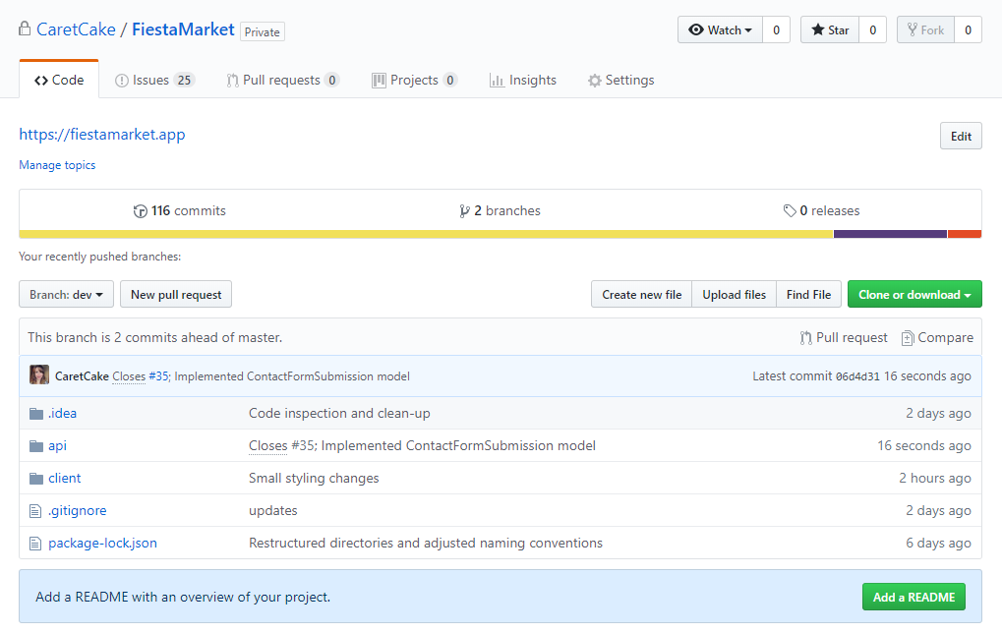
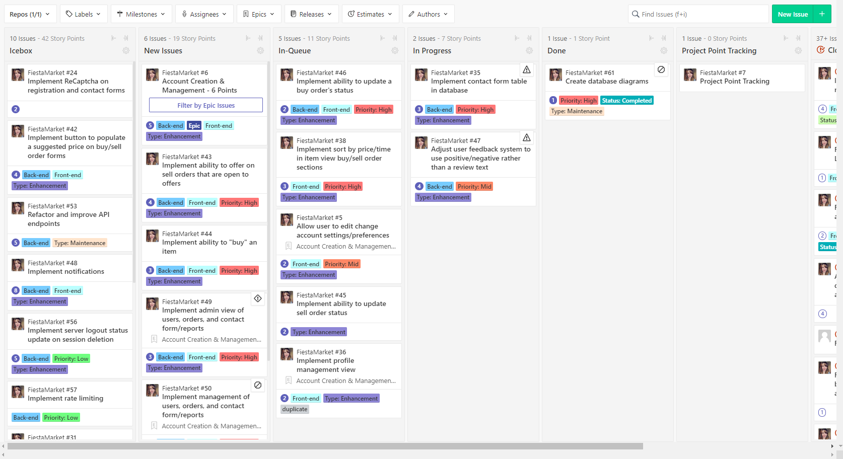
Misc. Details
Recruited some Fiesta Online players to test the site and provide feedback
Used Github version control
Tracked progress through Zenhub

Slide 11
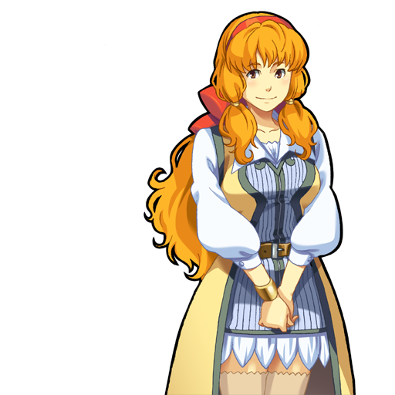
Retrospective: Adjusting Trajectory
Figuring out where to start
This library, that library, or DIY?
GraphQL -> Sequelize
React Redux
Learning React
Hosting, DNS, and server troubleshooting
Reevaluating based on user feedback
Adjusting player reputation/review feature plans

Slide 12


DEMO

